Slide 1

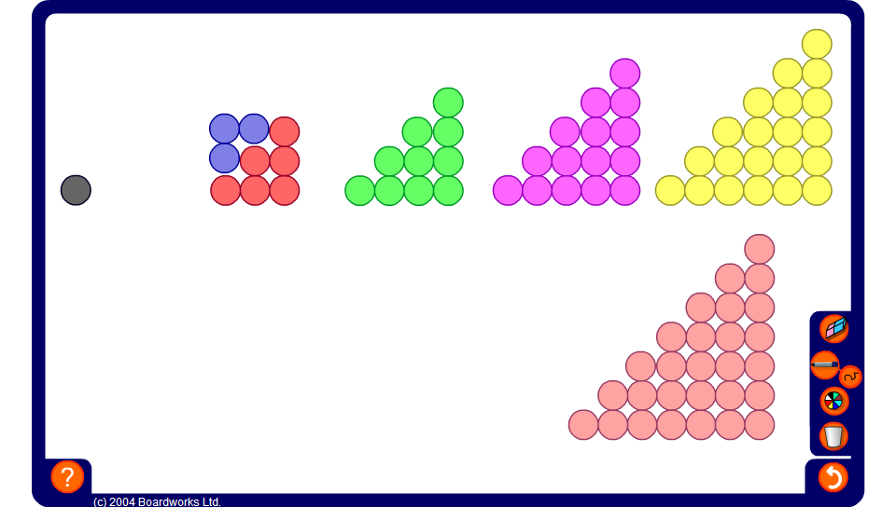


Adding consecutive triangular numbers
Notes:
Establish that the number of counters in each arrangement for a triangular number.
Ask a volunteer to demonstrate on the board how we could combine the first two triangular arrangements to make a square arrangement.
Repeat this for the other triangular arrangements.
Ask pupils whether this proves that any pair of consecutive triangular numbers can be added together to make a square number.

